Slide 1



LET’S GO BEYOND
Trane EaaSy
ReThink HVAC

Slide 2
LET’S GO BEYOND
NOW YOU HAVE CHOICES
Your business needs cooling and/or heating equipment, but this is a significant capital investment.
Not any longer.
Trane can give you choices:
Trane EaaSy is a short-term or long-term rental program where you only pay for HVAC when you need it.
ReThink your approach to HVAC
General presentation
EaaSy
financials
EaaSy
flexibility
EaaSy
elimination of risk

Slide 3
Trane EaaSy: ReThink your approach to HVAC
REVOLUTIONARY APPROACH
Whether it’s a repair, an upgrade or a replacement, Trane can offer a revolutionary approach to meet your needs.
Forget investing and owning your HVAC system – we can give you «Equipment-as-a-Service».
It’s HVAC made simple, or in one word: EaaSy.
General presentation
EaaSy
financials
EaaSy
flexibility
EaaSy
elimination of risk
ReThink

Slide 4
Trane EaaSy: ReThink your approach to HVAC
BENEFITS
With Trane EaaSy, you get:
No upfront cost, positive cash flow
The latest technology
Easy switching to more powerful equipment
Minimized running costs and a fixed monthly rate
Full maintenance and warranty cover
Total reliability, total availability
Zero risk and maximum flexibility.
General presentation
EaaSy
financials
EaaSy
flexibility
EaaSy
elimination of risk
ReThink

Slide 5
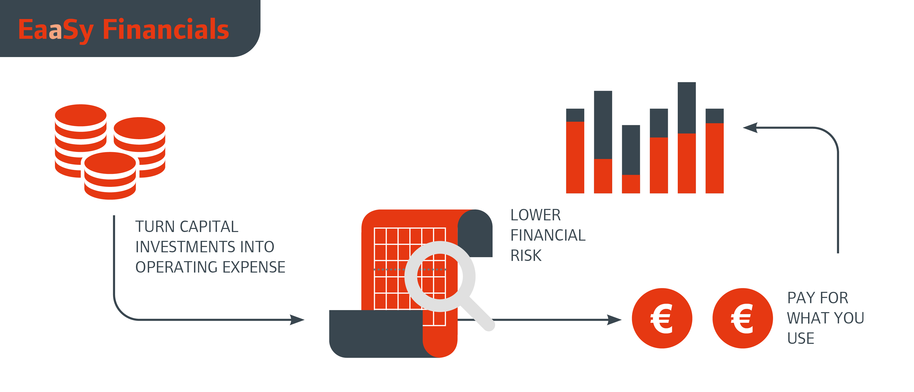
Trane EaaSy: ReThink your approach to HVAC
THE DETAILS
Duration up to 9 years, with optional upgrades
Full new-for-old replacement on renewal of contract
3 rates:
  In use
  In standby at customer premises
  In standby at Trane warehouse
Trane Select level 3 throughout the agreement
Optional 24/7 assistance
Optional remote monitoring
General presentation
EaaSy
financials
EaaSy
flexibility
EaaSy
elimination of risk
ReThink

Slide 6
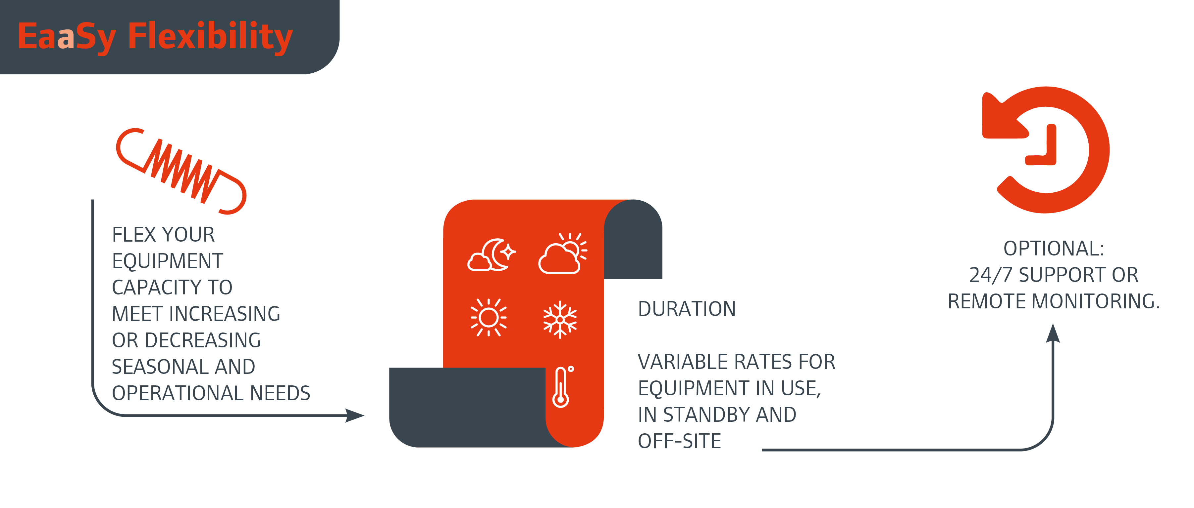
Trane EaaSy: ReThink your approach to HVAC
General presentation
EaaSy
financials
EaaSy
flexibility
EaaSy
elimination of risk
ReThink

Slide 7
Trane EaaSy: ReThink your approach to HVAC
EASY FINANCIALS – TURNING INVESTMENT INTO EXPENSE for a WIN-WIN
Forget about investing and owning your HVAC system. Trane EaaSy allows you to take an «Equipment-as-a-Service» approach.
We can help you transform a fixed asset into a dynamic system, with the flexibility to meet your needs as they evolve.
Full control of operating costs
Pay for what you use
Fixed monthly rate
Latest technology
Full coverage of maintenance and warranty
Highest reliability and availability, lowest financial risk.
Look at the
FINANCIAL ADVANTAGES
FINANCIAL ADVANTAGES
General presentation
EaaSy
financials
EaaSy
flexibility
EaaSy
elimination of risk
ReThink

Slide 8
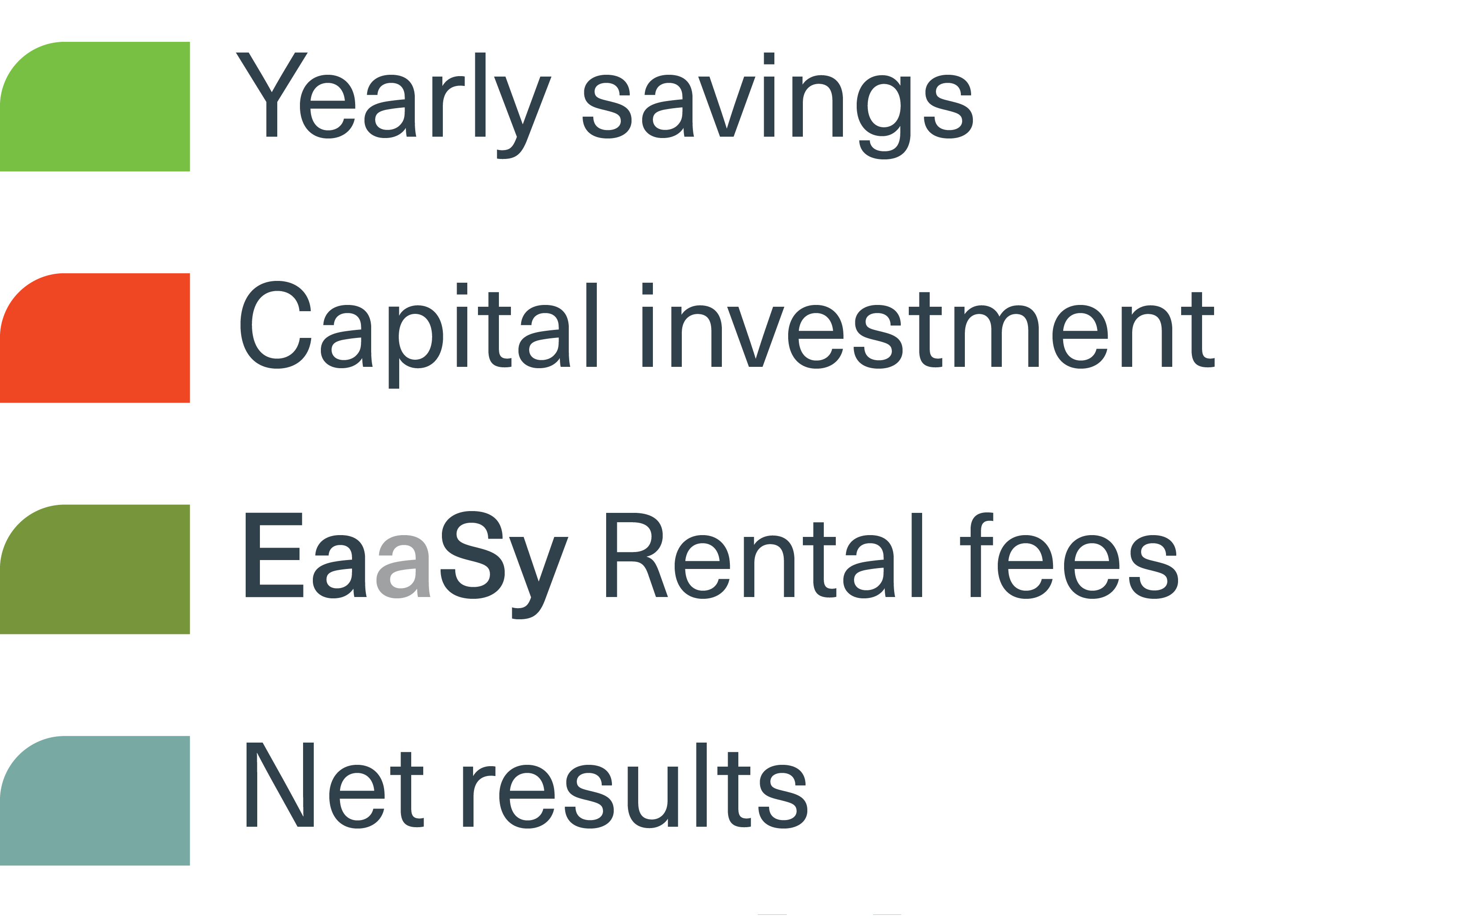
Trane EaaSy: ReThink your approach to HVAC
PAY FOR WHAT YOU NEED, WHEN YOU NEED IT
  Chiller in use: Pay for standard rental
  Contingency planning:
  Why pay for a piece of equipment you may not use?
  Depending on your level of business criticality, select:
    EaaSy Standby: At Trane depot or on your premises, ready to be connected.
    EaaSy Partial use for seasonality :
    Pay in full when you are using, otherwise pay a reduced rate.
General presentation
EaaSy
financials
EaaSy
flexibility
EaaSy
elimination of risk
ReThink

Slide 9
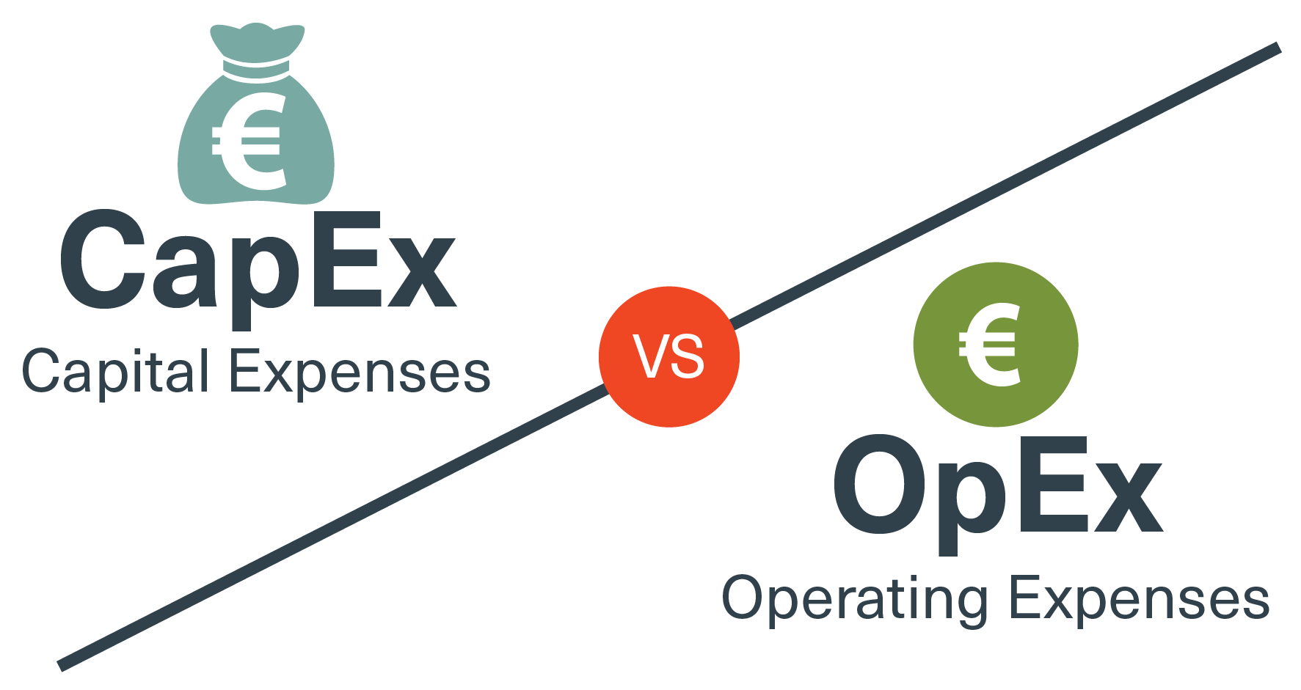
Trane EaaSy: ReThink your approach to HVAC
FINANCIAL ADVANTAGES
Trane EaaSy eliminates the resistance created by a long payback period.
Customers can enjoy positive net results of the TBA initiative already on the first day.
All Trane made products can be «EaaSy».
General presentation
EaaSy
financials
EaaSy
flexibility
EaaSy
elimination of risk
ReThink

Slide 10
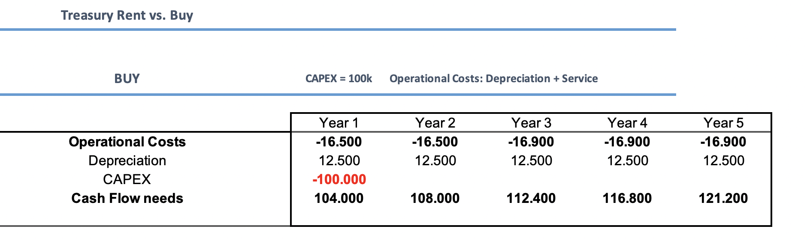
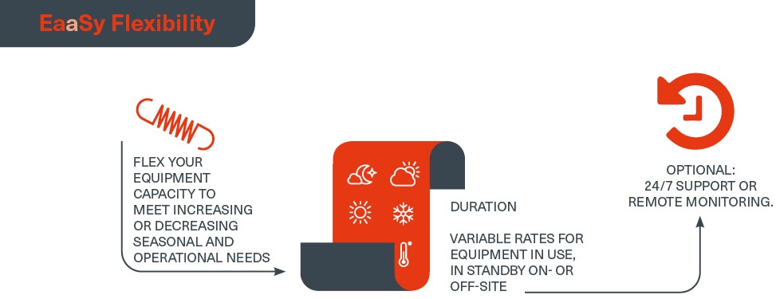
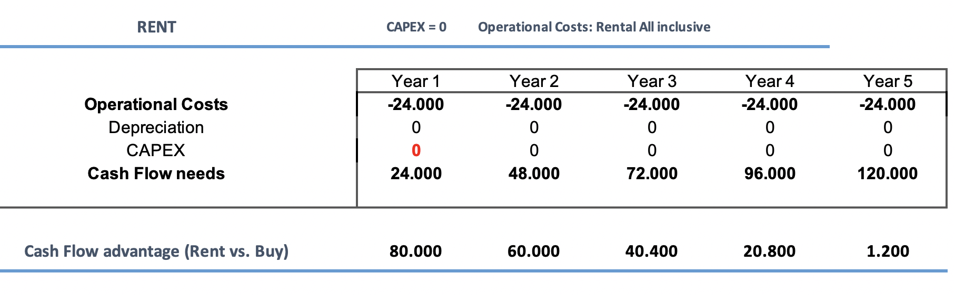
Trane EaaSy: ReThink your approach to HVAC
STRONG CASH FLOW ADVANTAGE WITH
NO OPERATIONAL COST VARIANCE
  With a traditional investment, you need to pay in advance to reach a break even point. Positive cash flow can take years.
  With EaaSy, no need to wait. And no major investment. Just pay rental and reap the benefits of your state-of-art chiller from day 1.
  The table shows that a €100K investment can generate positive cashflow for 5 years. Then, thanks to the EaaSy concept, you will be entitled to upgrade your equipment with a more efficient unit and profit from positive cashflow again.
Financing + Maintenance
Rental
General presentation
EaaSy
financials
EaaSy
flexibility
EaaSy
elimination of risk
ReThink

Slide 11

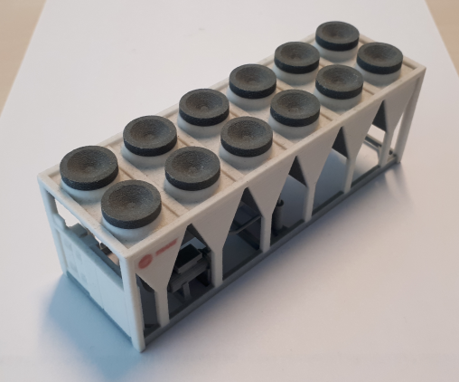
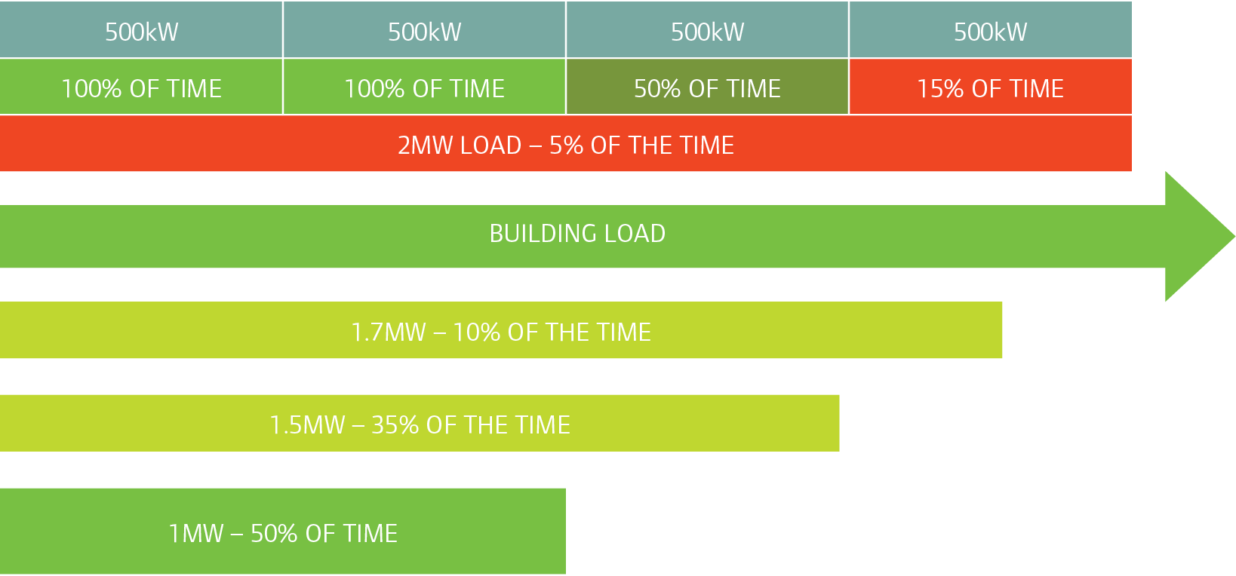
Trane EaaSy: ReThink your approach to HVAC
General presentation
EaaSy
financials
EaaSy
flexibility
EaaSy
elimination of risk
ReThink

Slide 12
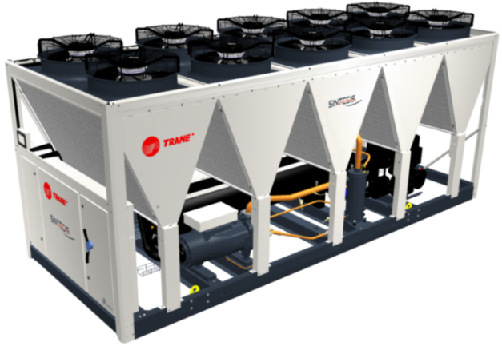
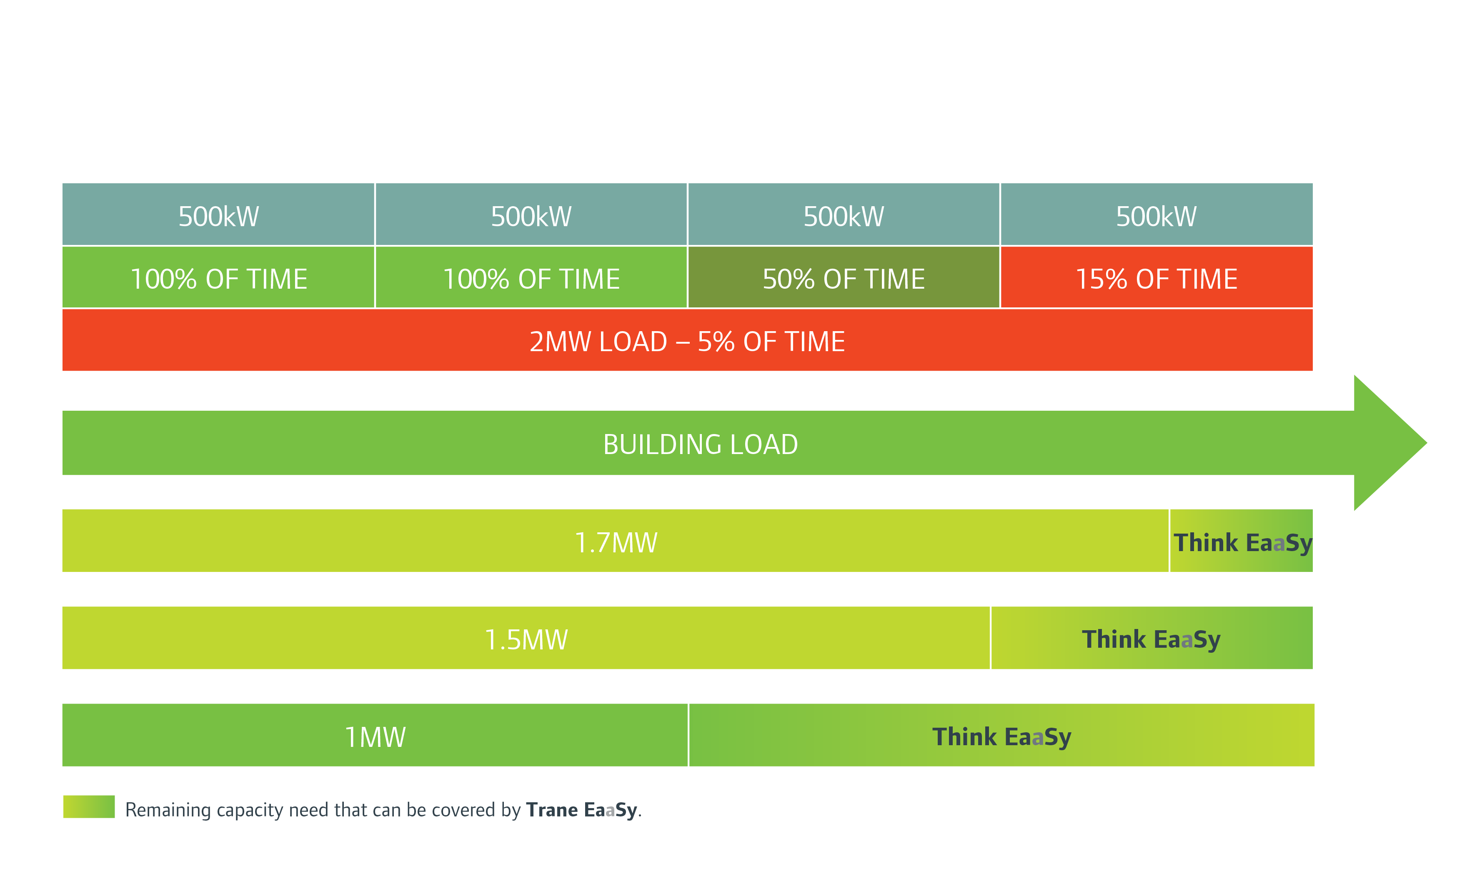
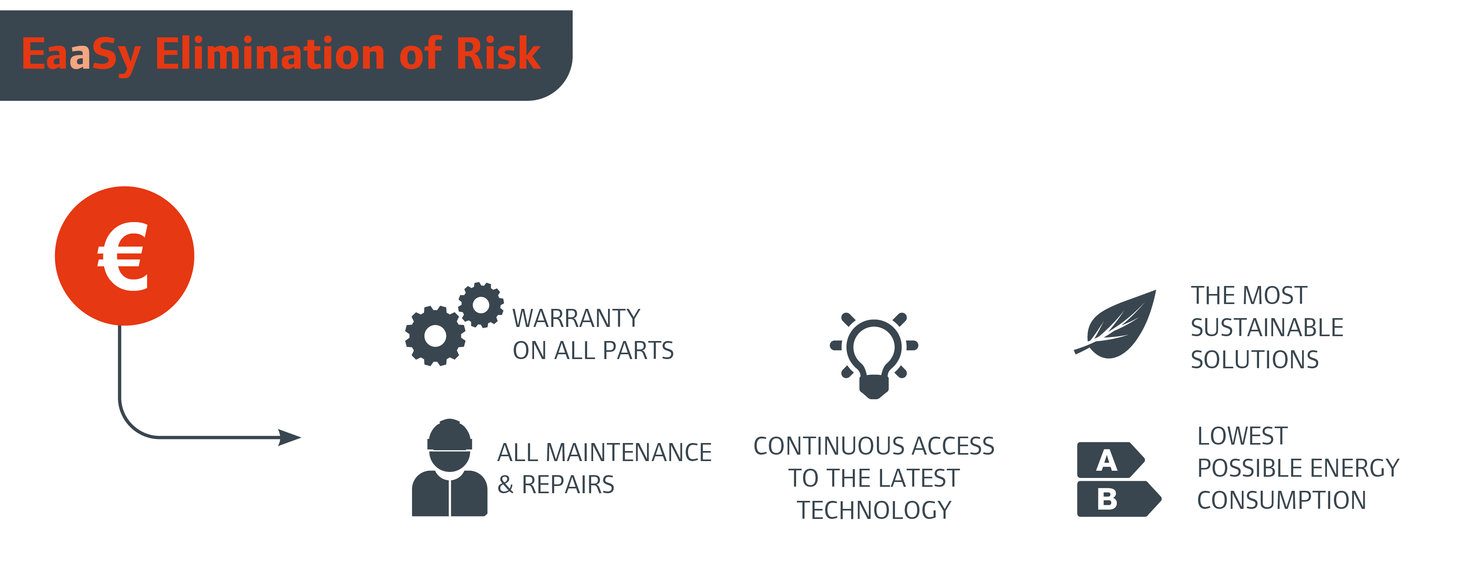
Trane EaaSy: ReThink your approach to HVAC
General presentation
EaaSy
financials
EaaSy
flexibility
EaaSy
elimination of risk
ReThink

Slide 13
Trane EaaSy: ReThink your approach to HVAC
General presentation
EaaSy
financials
EaaSy
flexibility
EaaSy
elimination of risk
ReThink

Slide 14
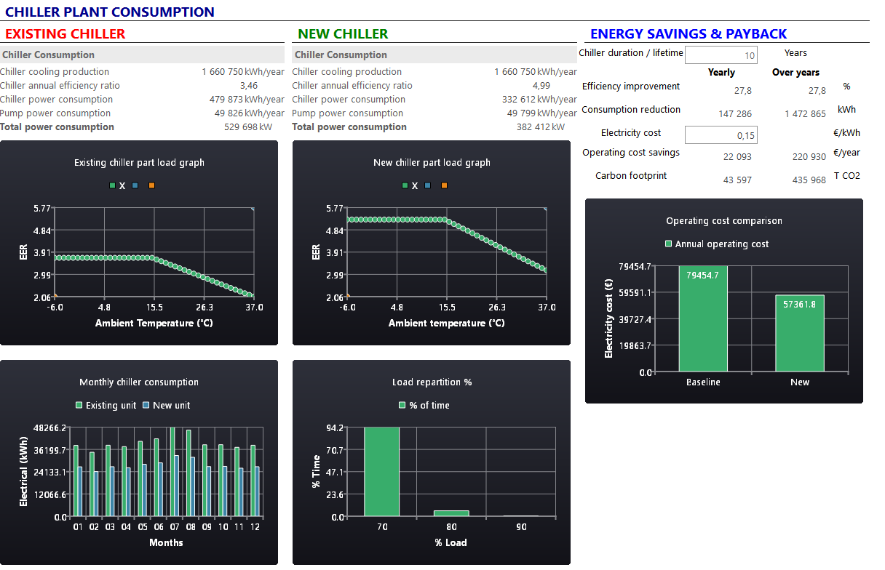

Trane EaaSy: ReThink your approach to HVAC
Our new TBA EaaSy tool shows you your energy savings
General presentation
EaaSy
financials
EaaSy
flexibility
EaaSy
elimination of risk
ReThink

Slide 15
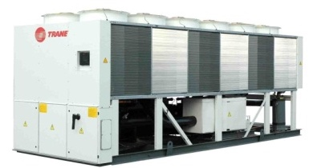
Trane EaaSy: ReThink your approach to HVAC
Your business is evolving.
But so are your HVAC and cooling needs.
Maybe you need a larger or smaller unit than originally planned? Maybe you no longer need cooling?
Trane will upgrade your equipment to meet your new needs.
And what if, after 5 years, a new Trane chiller is released
with +30% efficiency?
You simply request an upgrade.
General presentation
EaaSy
financials
EaaSy
flexibility
EaaSy
elimination of risk
ReThink

Slide 16

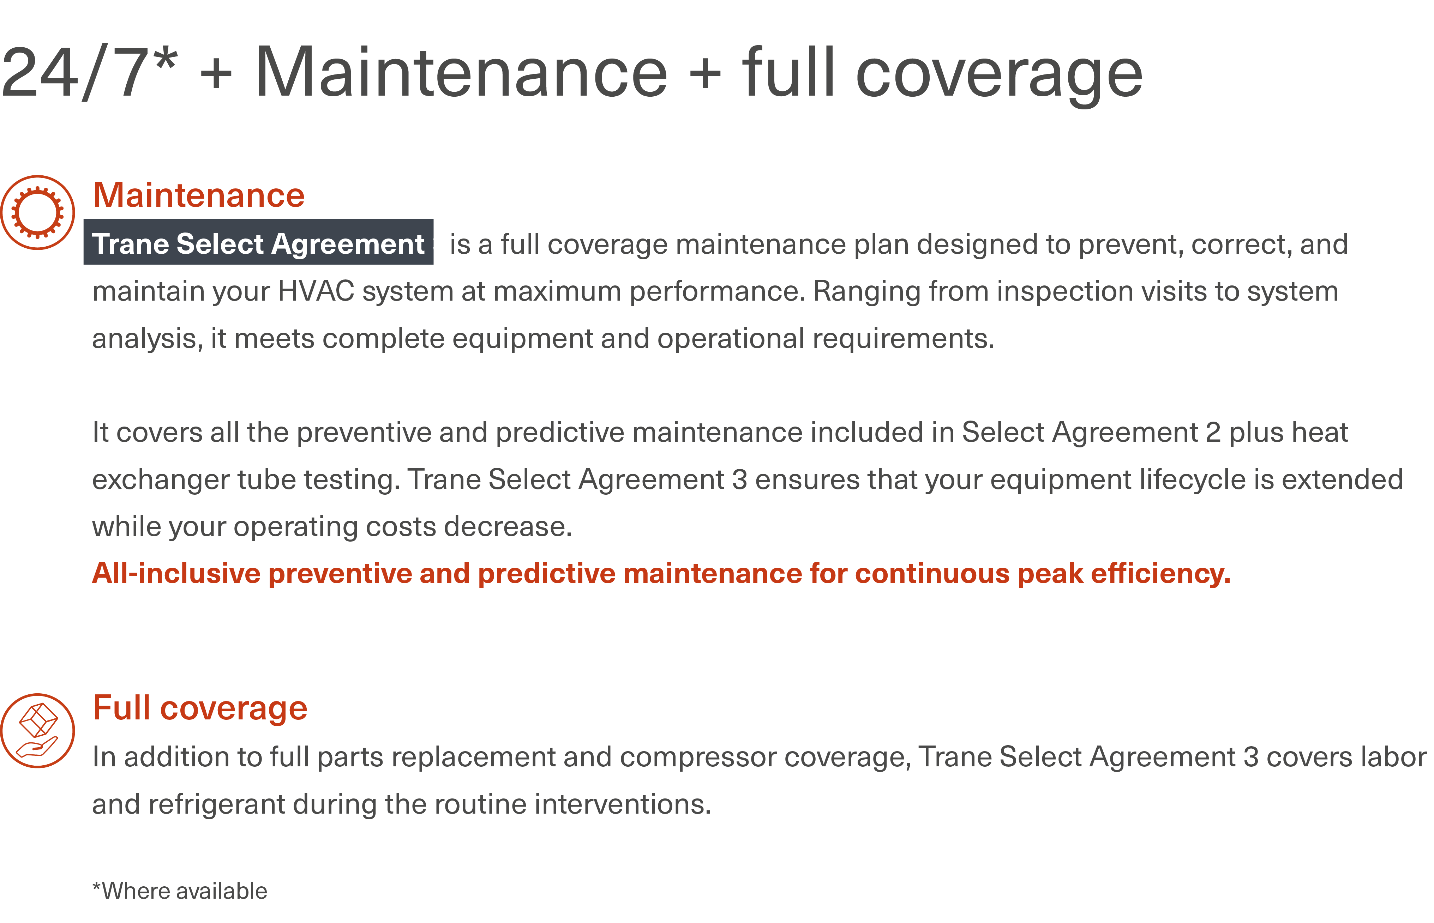
Trane EaaSy: ReThink your approach to HVAC
RISK MANAGEMENT
General presentation
EaaSy
financials
EaaSy
flexibility
EaaSy
elimination of risk
ReThink

Slide 17
THANK YOU
ReThink

